Slide 1
Machine Learning and Modeling Techniques– Linear Regression
Cuny LaGUardia community college

Slide 2
What is linear regression?
An example: Shaquille O’Neal is really tall – 7ft 1in. If Shaq has a son, chances are that his son will be pretty tall. However, since Shaq is such an anomaly, there is also a very good chance that his son will not be as tall as Shaq.
As it turns out, Shaq’s son is tall – 6ft 7in, but not nearly as tall as Shaq. This is called regression. You can think of it as “a father’s sons height tends to regress (or drift towards) the mean (average) height.”

Slide 3
What is linear regression?
Regression searches for relationships among variables.
For example, you can observe several employees of some company and try to understand how their salaries depend on the features, such as experience, level of education, role, city they work in, and so on.
The dependent features are called the dependent variables, outputs, or responses.
The independent features are called the independent variables, inputs, or predictors.

Slide 4
What is linear regression?
Regression problems usually have one continuous and unbounded dependent variable. The inputs, however, can be continuous, discrete, or even categorical data such as gender, nationality, brand, and so on.
It is a common practice to denote the outputs with 𝑦 and inputs with 𝑥. If there are two or more independent variables, they can be represented as the vector 𝐱 = (𝑥₁, …, 𝑥ᵣ), where 𝑟 is the number of inputs.

Slide 5
When do you need regression?
“Typically, you need regression to answer whether and how some phenomenon influences the other or how several variables are related. For example, you can use it to determine if and to what extent the experience or gender impact salaries.”
Regression is also useful when you want to forecast a response using a new set of predictors. For example, you could try to predict electricity consumption of a household for the next hour given the outdoor temperature, time of day, and number of residents in that household.

Slide 6

What is linear regression?
Linear regression is probably one of the most important and widely used regression techniques. It’s among the simplest regression methods. One of its main advantages is the ease of interpreting results.

Slide 7
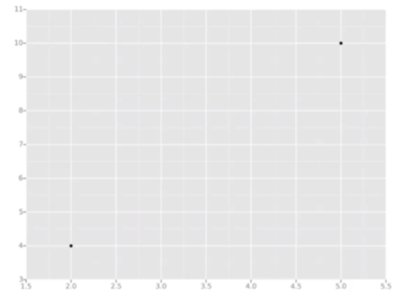
Example
Lets create the simplest type of regression possible: 2 data points

Slide 8
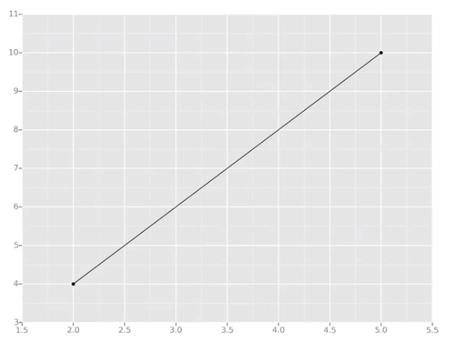
Example
What we’re trying to do is draw a line that’s as close as possible to every dot.
In classic linear regression, or “least squares method”, you only measure the closeness in the “up and down direction”.

Slide 9
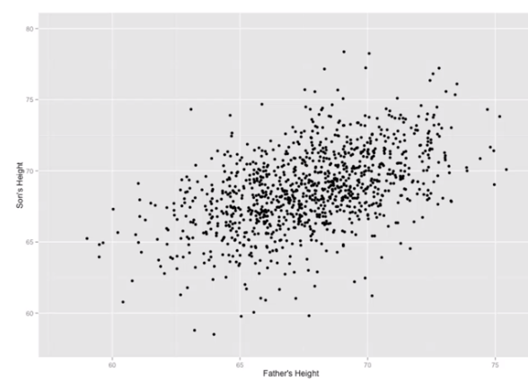
Linear regression
By doing this method, and with enough data, we might even be able to tell things like how tall someone's son might be before they’re even born!

Slide 10
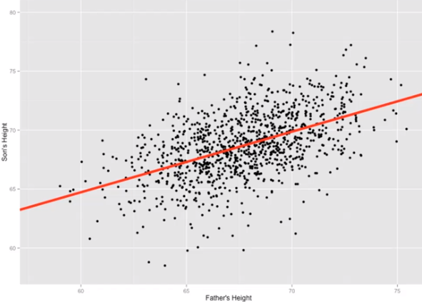
Linear regression
The goal with linear regression is to minimize the vertical distance between the data points and our line.
To determine the best line, we attempt to minimize the distance between all points and our line

Slide 11
Variables?
The Dependent Variable – the variable who's values we want to explain. It DEPENDS on something else.
The Independent Variable – the variable that explains the dependent variable.

Slide 12
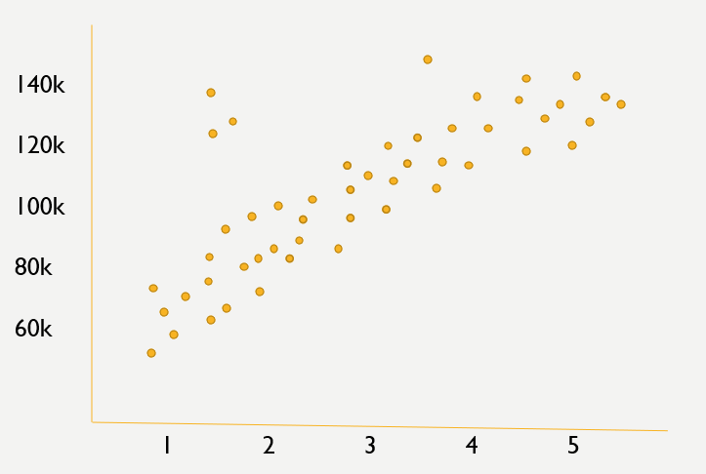
Suppose we have data relating to years of exp. Vs. salary

Slide 13
How do we decide what kind of line?
The employer wants this type of line …

Slide 14
How do we decide what kind of line?
While the employee wants this type of line …

Slide 15
How do we decide what kind of line?
Prediction line

Slide 16
How do we decide what kind of line?
Prediction line
140k
120k
100k
80k
60k
Residuals
1 2 3 4 5

Slide 17
How do we decide what kind of line?
Prediction line
140k
120k
100k
80k
60k
Residuals
(10)^2 + (10)^2 + (40)^2 …. = 550
1 2 3 4 5

Slide 18
Variables?
Experience is our independent variable.
Salary is our dependent variable.
The persons salary DEPENDS on their years of experience.

Slide 19
Regression performance
The coefficient of determination, denoted as 𝑅², tells you which amount of variation in 𝑦 can be explained by the dependence on 𝐱 using the particular regression model. Larger 𝑅² indicates a better fit and means that the model can better explain the variation of the output with different inputs.
The value 𝑅² = 1 corresponds to SSR = 0, that is to the perfect fit since the values of predicted and actual responses fit completely to each other.

Slide 20
Linear regression
https://www.youtube.com/watch?v=CtKeHnfK5uA

Slide 21
Break – 20 mins

Slide 22
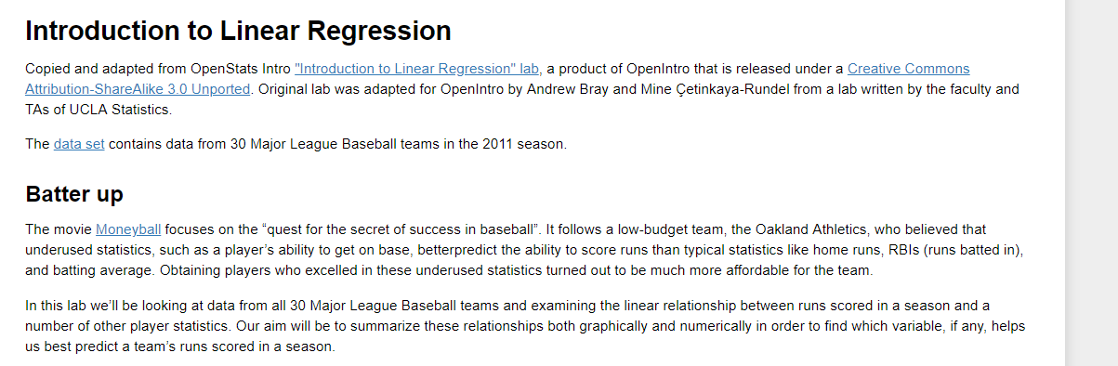
Open intro statistics lab
Open the ‘Lesson11_LinearRegression.ipynb’ file and complete the lab on linear regression. Upload your completed lab to your github account.
This lab is provided by OpenIntro Statistics – adapted by Hack University. Openintro statistics is a free online statistics text book.

